Slide 1
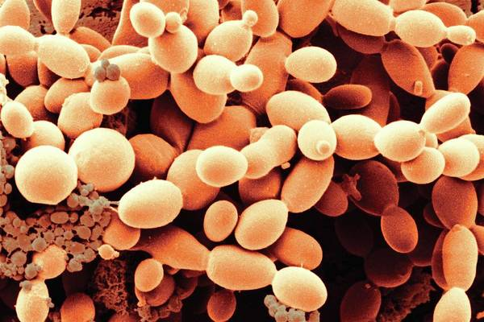
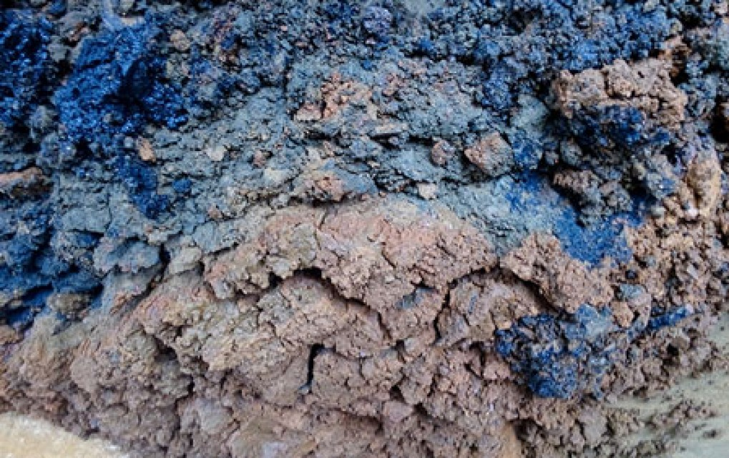
A presentation on the Undergrad Thesis
Assessment of Textile Sludge
Leachate Toxicity by a
Saccharomyces Cerevisiae
Specific Growth Rate Study
Suprio Kamal 1502026
MD. Shahriar Hossain 1502033
Supervisor: Dr. Mohidus Samad Khan
Associate Professor
Dept. of Chemical Engineering
BUET

Slide 2
Background
The Textile Industry of Bangladesh is its strongest contributor of Foreign export to date.
The RMG Sector has earned about 27.95 b$
in the fiscal year of 2019-20.
This makes the industry responsible for almost 83% of the total export of Bangladesh, while contributing to 11.17% of the national GDP.
Reference: BGMEA export performance.
Khairul Akter, M. M. (2020, February 22). Review and Outlook, 2020 Bangladesh Garments and Textile Industry. Textile News, Views & Articles.
Notes:
a remarkable 83% of the total export of Bangladesh comes from this sector alone, while contributing to 11.17% of the national GDP.

Slide 3
Background
However, this large source of income is not without its demons.
The RMG Sector is one of the largest consumers of water and chemicals in our country.
In the fiscal year of 2018-2019, almost 1.95 million metric tons of textile chemicals were consumed to produce 2.69 million metric tons of fabric.
Caustic Soda, Chlorine, Chlorinated paraffin wax, H₂O₂, Hydrochloric Acid, NaClO, bleaching powder, Sulfuric acid, Soda Ash, Glauber salt
Anti-creasing agent, wetting agent, soaping agent, Fixing agent, Enzymes
Waste water production from this industry will reach almost 349 million m³ by 2021.
Reference: Annual Report - Year 1. (2020). EsTex Group, BUET.
Haque, F., Khandaker, M. M. R., Chakraborty, R., & Khan, M. S. (2020). Identifying Practices and Prospects of Chemical Safety and Security in the Bangladesh Textiles Sector,
Journal of Chemical Education, 97(7), 1747–1755.
Notes:
It is reported that in the fiscal year of 2018-2019, almost 1.95 million metric tons of textile chemicals were consumed to produce 2.69 million metric tons of fabric

Slide 4
The Waste Problem
This large amount of water has to be treated in ETPs, each operating in a variety of ways to treat specific kinds of waste, utilizing different chemical and biological substrates.
It is reported that the textile sector of Bangladesh discharges 2 million m³ each day
and at least 2.81 million metric ton sludge is produced every year .
Heavy Metals: Titanium, Zinc, Nickel, Manganese, Lead, Cadmium, Ruthenium, Arsenic, Chromium
Other elements: Sodium, Sulfur Calcium, Iron, Potassium, Magnesium and Copper
Reference: Arun Kanti Guha, Oaliur Rahman, Sumit Das, Md. Sazzad Hossain, Characterization and Composting of Textile Sludge, Resources and Environment.
Haque, F., Khandaker, M. M. R., Chakraborty, R., & Khan, M. S. (2020). Identifying Practices and Prospects of Chemical Safety and Security in the Bangladesh Textiles Sector. Journal of Chemical Education, 97(7), 1747–1755.
Notes:
Heavy metals are responsible for a variety of serious health issues, or may cause adverse ecological reactions which affect the environment negatively. They are dangerous because of their non-biodegradable nature, long biological half-lives and their tendency to accumulate and amplify in the living body. As such, these textile wastes have become a major source of pollution for our environment.

Slide 5
The Waste Problem
Halim et al. reported for textile sludge from Gazipur industrial area
Huang et al found for textile sludge
Reference: Islam, M. M., Halim, M. A., Safiullah, S., Hoque, S. W., & Islam, M. S. (2009). Heavy metal (Pb, Cd, Zn, Cu, Cr, Fe and Mn) content in textile sludge in Gazipur, Bangladesh. Research Journal of Environmental Sciences, 3(3), 311-315
Huang, M., Chen, L., Chen, D., & Zhou, S. (2011). Characteristics and aluminum reuse of textile sludge incineration residues after acidification. Journal of Environmental Sciences, 23(12)
Notes:
Heavy metals are responsible for a variety of serious health issues, or may cause adverse ecological reactions which affect the environment negatively. They are dangerous because of their non-biodegradable nature, long biological half-lives and their tendency to accumulate and amplify in the living body. As such, these textile wastes have become a major source of pollution for our environment.

Slide 6
Objective
Characterize the Leachate extract of Sludge from different textile industries.
Attempt to develop a method of testing and measuring the toxicity of Sludge leachate extracts using microbial assays of Saccharomyces cerevisiae .
Notes:
Heavy metals are responsible for a variety of serious health issues, or may cause adverse ecological reactions which affect the environment negatively. They are dangerous because of their non-biodegradable nature, long biological half-lives and their tendency to accumulate and amplify in the living body. As such, these textile wastes have become a major source of pollution for our environment.

Slide 7
Studies so far
Ecotoxicological impact study of textile sludge can be broadly divided into three sections based on the subject used to study toxicity. Of the 15 or so studies done for ecotoxicological studies using living organisms -
Plants – Oats, Field Mustard, Lettuce, Soybean, Wheat, Wild Cabbage, Sunflower
Animals – Daphnia magna (micro crustacean), P.reticulata (guppy fish), B.plicatili (rotifier), Hydra attenuata (cnidarian), E.foetida (earthworm), Albino mice
Microbes – V. fischeri, Salmonella sp., B. plicatilis
It is apparent that there is a broad scope for study on the impact of textile sludge on the ecology, especially the soil. Study of ecotoxicological impact of sludges using soil microbiota is of great potential in this regard.

Slide 8
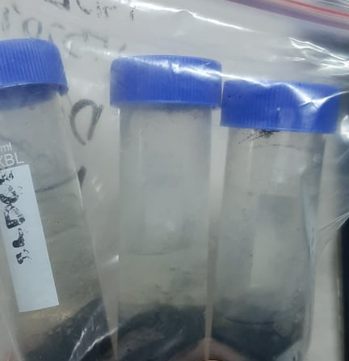
Sludge Characterization
Sludge is the solid material removed during the treatment of wastewaters.
Sometimes used as a general term for solids separated from suspension in a liquid material,
usually contains significant quantities of wastewater.
We worked with sludge samples of two different industries,
Detail | Industry A | Industry B
Factory Type | Woven | Composite
ETP Type | Activated Sludge Process, Anaerobic | Aerobic
+ water
Whatman no. 42
Dry Sludge
Sludge Slurry
Leachate Extract (Sample for Characterization)
Orbital shaker
1:10 by mass ratio
Shaken for 18h
Centrifuge
3500 rpm for 30 min
Filtration
Leachate Extract (Sample for kinetics)
Sterile .22 um syringe filter
Notes:
Air-dried sludge was taken in a 1:10 by mass ratio in water and agitated in an orbital shaker for 18h. This ensured proper mixing and dissolution of the metals in the solution. The agitated solution was then centrifuged at 3500 rpm for 30 min or until a clear supernatant was obtained. The clear supernatant was then filtered through a Whatman No. 42 filter paper. This filtered solution is the leachate extract.

Slide 9
Sludge Characterization
List of tests performed -
No. | Parameters | Standards/Procedures
1 | Moisture Content (%): As Recived Basis | ASTM E871-82
2 | Moisture Content (%): Dry Basis | -
3 | Ash Content (%) (580 C) | ASTM D1102-84
4 | Volatile Organic Matter (%) (950 C) | ASTM E872-82
5 | Fixed Carbon (%) | -
No. | Parameters | Standards/Procedures
6 | pH | HACH HQ40-D
7 | Electrical Conductivity | HACH HQ40-D
8 | Total Dissolved Solids (mg/L) | HACH HQ40-D
9 | Specific Gravity (gm/cc) | ASTM D854-14
10 | Total Hardness (ppm) | HACH Method #8213
11 | Alkalinity (mg/L) | HACH Method #8203
12 | Phosphate (mg/L) | HACH Method #8114
13 | Elemental Analysis | TX-RF
Equipment used for sludge characterization
Muffle Furnace for thermogravimetric tests
HACH DR 6000 for spectrophotometric methods
GNR TX 2000 for TX-RF elemental analysis

Slide 10
Characterization Results

Slide 11
Kinetic Study
How to measure toxicity of a substance in biological context?
What are the parameters to observe, more importantly – QUANTIFY?
At what level does these parameters manifest?
Biomass Production - Quantifiable
Germination Rate (plants) - Quantifiable
Organ Deformities (higher species- mammals etc.)
Population (most species including microbes) – Quantifiable } MIC, MBC, EC₅₀ tests
(these are also known as lethality assays)
Sp. Growth Rate/Doubling Time (mostly microbes) - Quantifiable
Macroscopic
Microscopic/Molecular
Enzyme Activity - Quantifiable
DNA replication - Quantifiable
Chromosomal Deformities - Quantifiable
}
Genotoxicity Tests

Slide 12
Macroscopic Assays (Assay is the jargon for “tests”!)
Takes relatively longer time (from 15 hours to multiple days)
Labor Intensive
Inexpensive Species/Strain Exclusive
Microscopic Assays
Expensive
Most experiments are done in a day
Results can be extrapolated into higher species

Slide 13
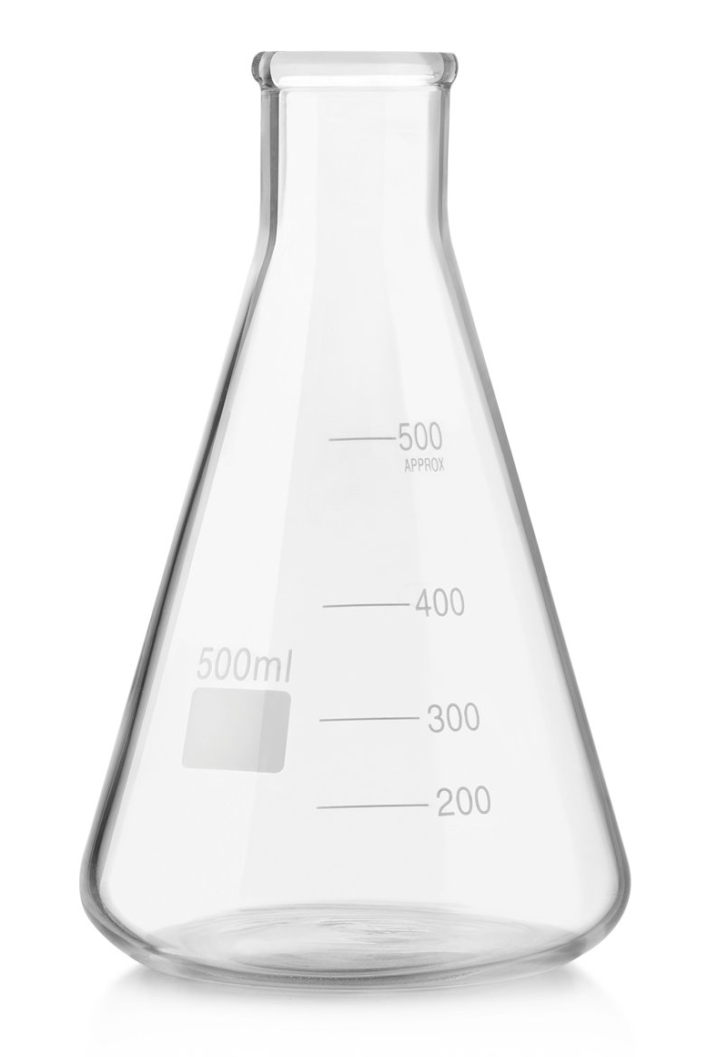
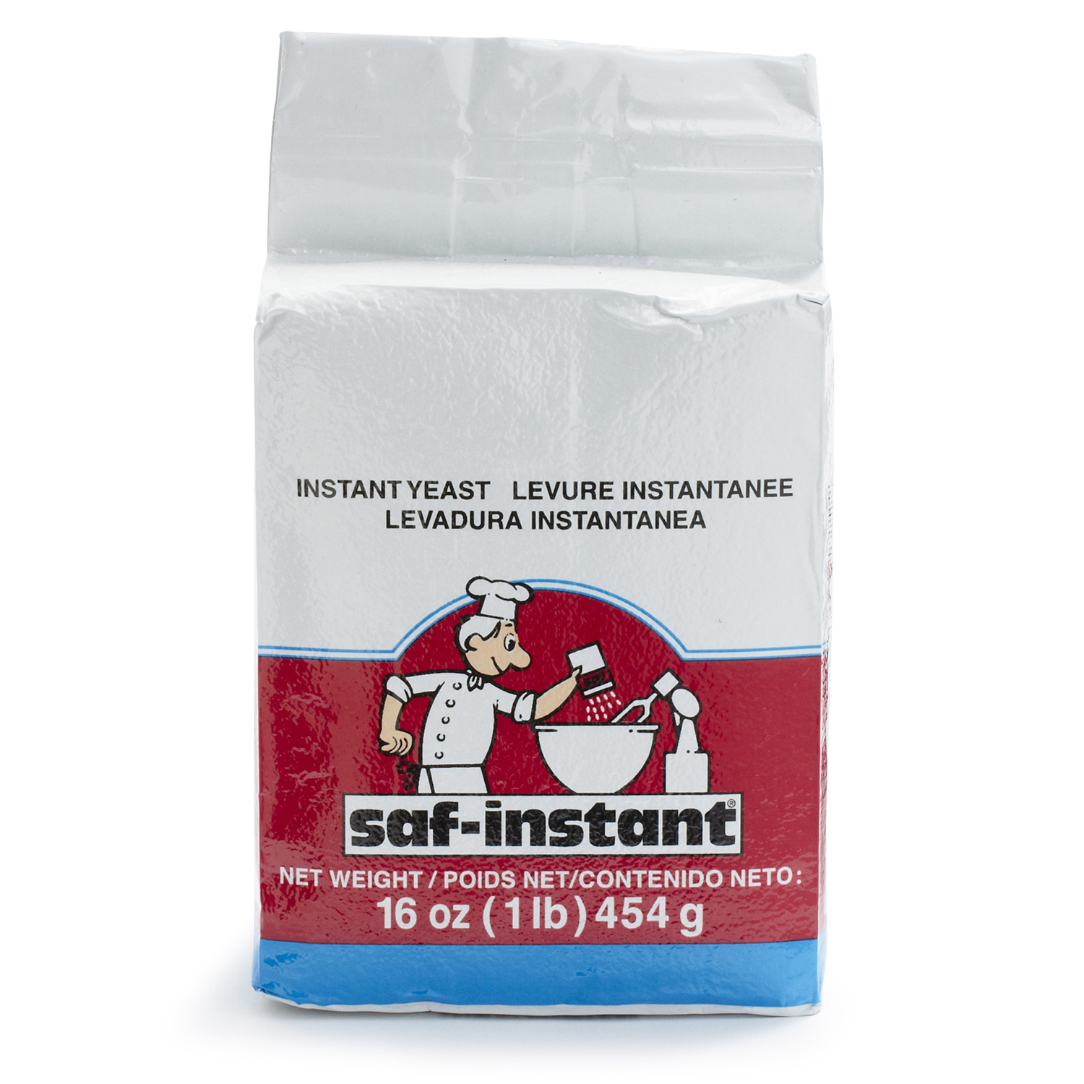
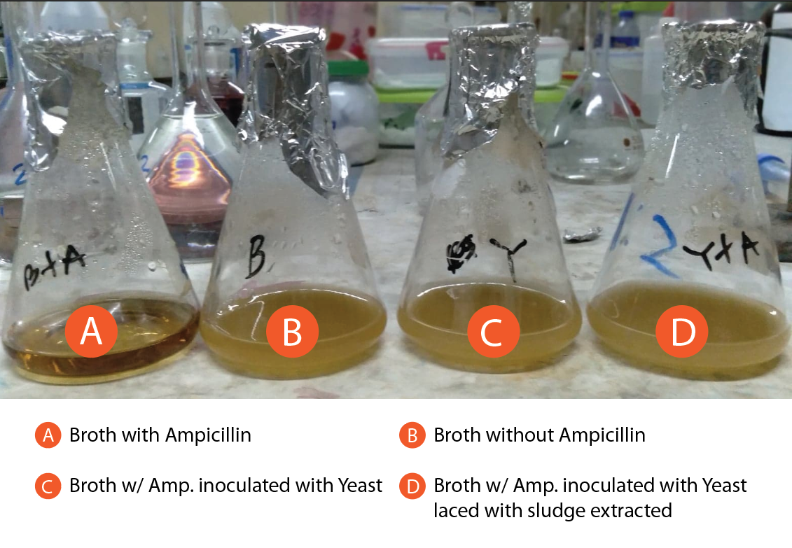

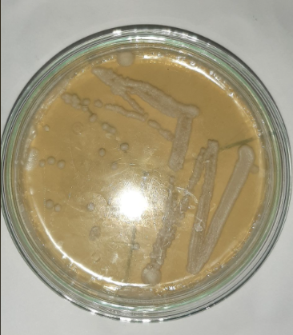
Inoculum Preparation
5 hours
Preserving Yeast
By Plating
YPD
2mL inoculum+ A mL YPD (w/Antibiotic)+ Z mL leachate
20 mins
Total Volume = 40 mL in 250 mL conical flask
Incubate at 32ºC with 220-250 rpm shaking
Culture for Growth Curve
9-10 hours
2 mL + 40 mL Fresh YPD Incubate Overnight
OD= 1.5-2.1
Sample at 1 hr interval for OD, total 9 hours
X mL + 40 mL Fresh YPD
Dilute to OD 0.2-0.3
Incubate 3-4 hours
Plate by Streaking
Until OD 0.5-0.6
Inoculum Preparation

Slide 14
Kinetic Study Results
Doubling time = Ln (2) / SGR
Exponential Phase
OD = OD_{i} exp^{SGR x t}
Specific Growth Rate is the slope of Ln OD vs time plot
SGR= Specific Growth Rate

Slide 15
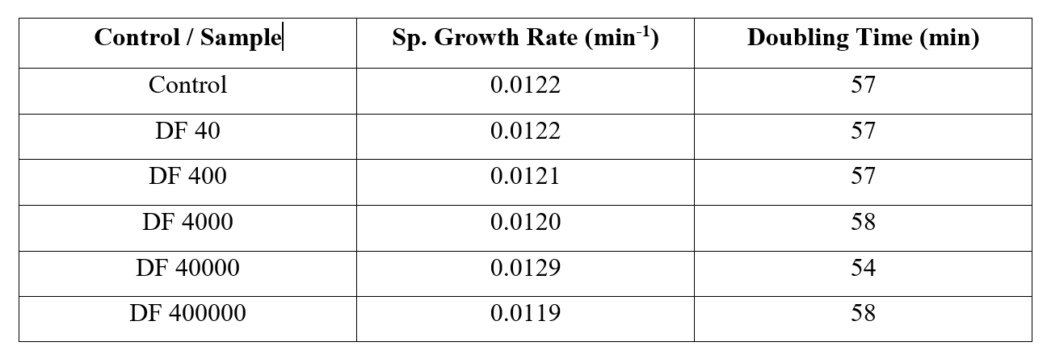
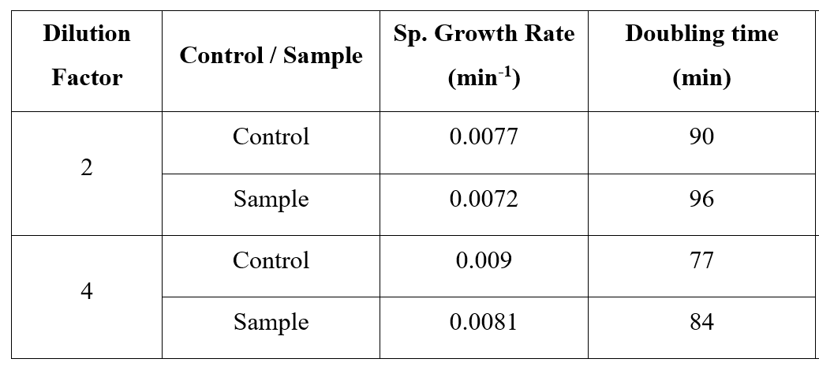
Kinetic Study Results
No Sensitivity towards Macroscopic Parameter of SGR!!
* DF 40-400000 done using ATCC yeast strains (S288C) revived from frozen state. *DF 2 and DF 4 studies were done on separate day on commercial baker yeast strain (proprietary strains). *Only compare Experimental with the corresponding control.

Slide 16
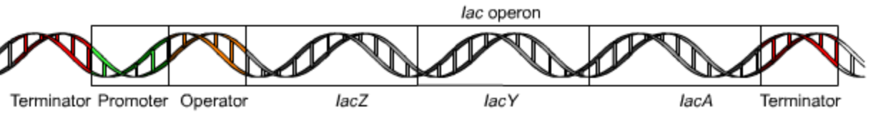
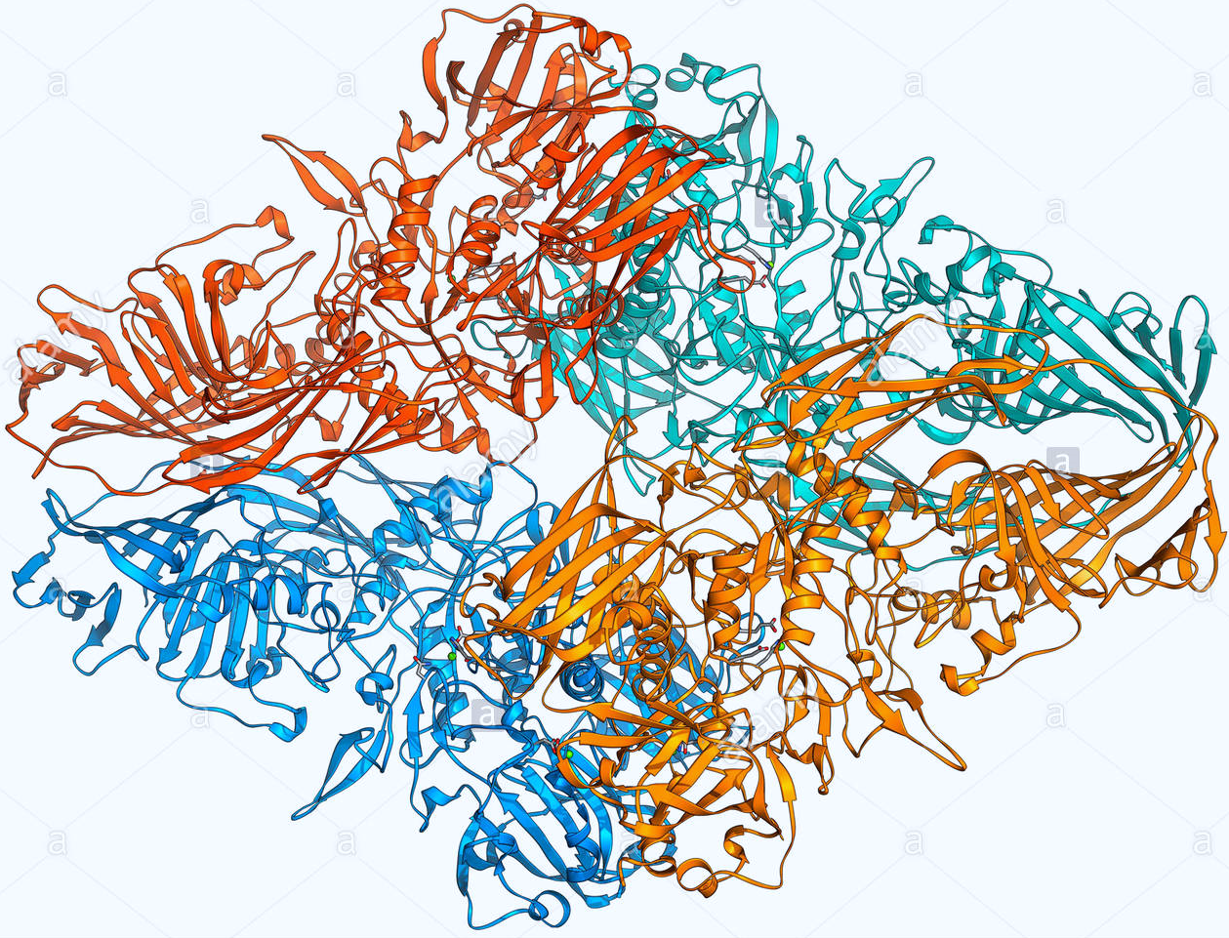
However, Yeast based assays are almost always used for Microscopic/Molecular scale tests- like genotoxicity Tests
A reporter gene RNR3-lacZ
Img Src. en.wikipedia.org/wiki/Lac_operon
In a YPD medium – no lactose but glucose is present So no activity of B-Gal should be seen! There are colorimetric assays to monitor this enzyme activity But carcinogenic and genotoxic substances (heavy metals, VOC, azo compounds, halo-alkyls, H₂O₂ etc) damage the DNA and the reporter genes are activated. Non-genotoxic or non-mutagenic substances do not induce this activity of reporter genes. So reporter genes are like biosensors for genotoxic substances!
Transcription & Translation
Img Src. RSC PDB
Beta-Galactosidase (B-Gal)
If Lactose is PRESENT & Glucose low/absent
Beta-Galactosidase
Is produced
Lactose
Glucose + Galactose
Reference: Jia, X., Zhu, Y., & Xiao, W. (2002). A stable and sensitive genotoxic testing system based on DNA damage induced gene expression in Saccharomyces cerevisiae. Mutation Research/Genetic Toxicology and Environmental Mutagenesis, 519(1-2), 83-92.

Slide 17
So, why yeast – Saccharomyces Cerevisiae?
Jia et al argues-
E.coli based genotoxic studies respond to DNA damage by a limited number of substances which act on the reporter RecA gene.
Cerevisiae is eukaryotic and potentially contains wider range of reporter genes (not only RNR3) which are not present in prokaryotic bacteria.
Depending on a single bioreporter for a wide (and possibly unknown) spectrum of toxic substances is unwise, specially when translating effects from prokaryotic into eukaryotic systems.
Yeasts are unicellular, robust to culture, has well established cloning protocols and not pathogenic towards human under typical culture conditions and environmentally friendly.
Reference: Jia, X., Zhu, Y., & Xiao, W. (2002). A stable and sensitive genotoxic testing system based on DNA damage induced gene expression in Saccharomyces cerevisiae. Mutation Research/Genetic Toxicology and Environmental Mutagenesis, 519(1-2), 83-92.
Elad, T., & Belkin, S. (2016). Reporter gene assays in ecotoxicology. In vitro Environmental Toxicology-Concepts, Application and Assessment, 135-157.

Slide 18
Conclusion
The Textile Industry of Bangladesh is a very significant and ever-growing sector of our industry. Thus it is of the utmost importance to take steps to make this industry sustainable and environmentally benign.
In this study we attempted to measure the extent of toxicity of characterized textile sludge leachate of two industries though growth-kinetics study of yeast (S. cerevisiae).
Yeast is a robust unicellular organism that is easy to source and culture, non-pathogenic. However, more tests are needed to determine a definite correlation and develop a reliable method to predict the toxic nature using yeast.
Performing growth-kinetic studies of yeast for a ecotoxicological study may have a better alternative in genotoxic studies.
It is advisable to initiate similar studies using other members of the soil microbiota such as Nitrobacter sp. Or other forms of fungi.

Slide 19

Thank You

Slide 20
Appendix
Property | Industry A | Industry B
Sludge Color | Black | Black
Moisture content (%): As Received Basis 105˚C | 85% | 84.37%
Moisture content (%): Dry Basis | 15.00% | 15.63%
Ash content (%) 580˚C | 13.08% | 16%
Volatile Organic Matter (%) 950˚C | 68.12% | 57.00%
Fixed carbon (%) | 3.80% | 11.37%
pH | 7.1 | 6.77
Electrical conductivity (µS/cm) | 7360 | 528
Total Dissolve Solid (TDS) (mg/L) | 3820 | 2560
Specific gravity (gm/cc) | 0.79 | 0.8
Total Hardness (PPM) | 720 | 850
Alkalinity (mg/L) | 470 | 360
Phosphate (mg/L) | 33.9 | 42.4

